Slide 1
Design and Analysis of Algorithms CS345
Lecture 37
Stable Matching Problem (Proof of Optimality)
Computing Median using less Space

Slide 2

Stable Marriage Problem
$M$ : set of $n$men
$W$ : set of $n$women
For each man $m∈M$,
$L(m)$: a preference list of all women
For each woman $w∈W$,
$L(w)$: a preference list of all men
Aim: To compute a stable marriage.

Slide 3
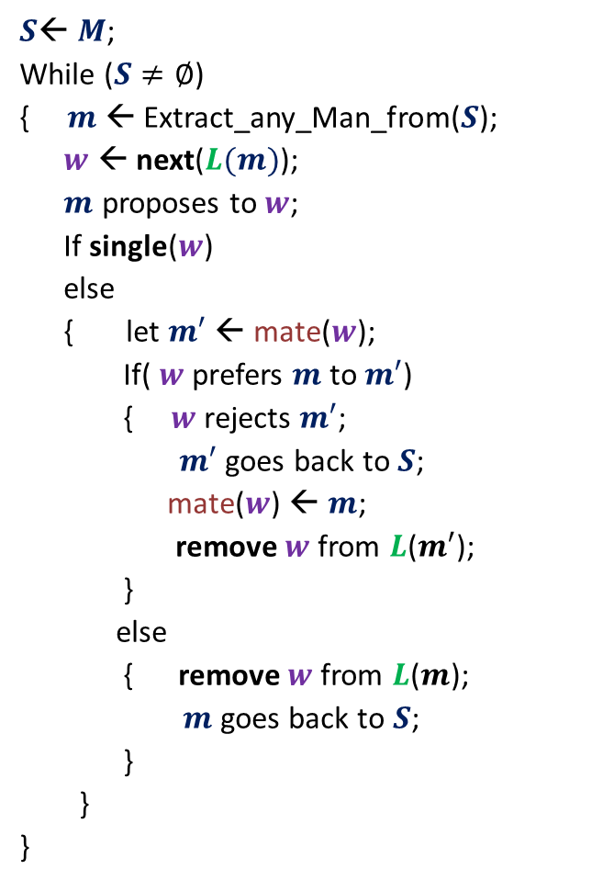



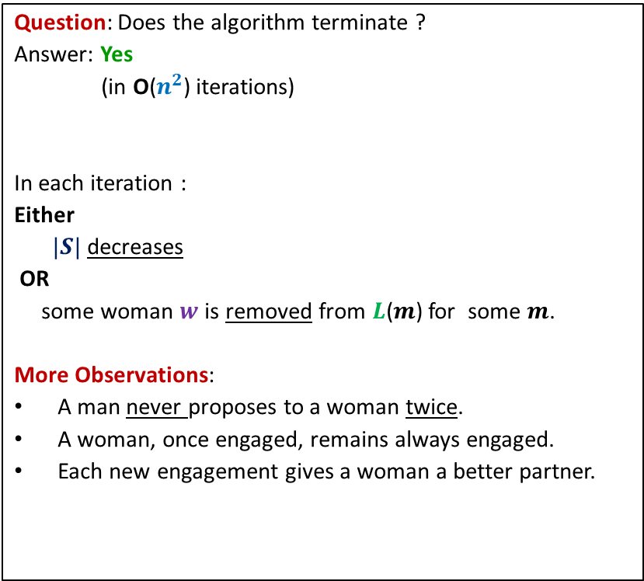
GaleShapley($M$, $W$)
$S$← $M$;
While ($S≠∅$)
{ $m$← Extract_any_Man_from($S$);
$w$ ← next($L(m)$);
$m$ proposes to $w$;
If single($w$)
else
{ let $m′$ ← mate($w$);
If( $w$ prefers $m$ to $m′$)
{ $w$rejects $m′$;
$m′$ goes back to $S$;
mate($w$) ← $m$;
remove $w$from $L$($m′$);
}
else
{ remove $w$from $L$($m$);
$m$ goes back to $S$;
}
}
}
Question: Does the algorithm terminate ?
Answer: Yes
(in O($n^{2}$) iterations)
In each iteration :
Either
$|S|$ decreases
OR
some woman $w$is removed from $L$($m$) for some $m$.
More Observations:
A man never proposes to a woman twice.
A woman, once engaged, remains always engaged.
Each new engagement gives a woman a better partner.
mate($w$) ← $m$;
Any measure of progress ?
in list $L(w)$, $m$precedes $m′$)

Slide 4
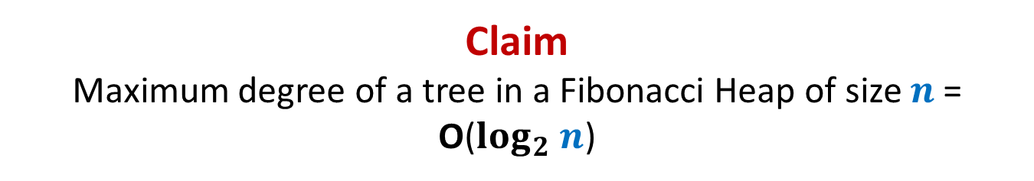







Stable Marriage Problem
Women
Men
$$w_{1}$$
$$m_{1}$$
$$w_{2}$$
$$m_{2}$$
proposal
proposal
$$w_{3}$$
$$m_{3}$$
$$w_{n}$$
$$m_{n}$$
Men Optimal
Women Pessimal
Women Optimal
Men Pessimal

Slide 5


Gale-Shapley($M$, $W$) (Proof of man-optimality)
What is the assertion whose proof will establish
man-optimality ?
This proof is for fun only.
It won’t be asked in any exam or assignment
Assertion:
Let $m$ be any man married to woman $w$ after the algorithm.
If $w′$ is a woman that man $m$ prefers to $w$,
Then there can not be any stable marriage in which $m$ is married to $w′$.
First attempt:
Let MA be any marriage in which $m$ is married to $w′$.
Let $w′$ be married to $m′$ at the end of the Gale Shapley algorithm.
Surely, $w′$ must be preferring $m′$ to $m$.
We shall show that ($w′$,$m′$) is an unstable pair in Marriage MA.
Of course, $w′$ prefers $m′$ to her current partner $m$ in Marriage MA.
But how to show that $m′$ prefers $w^{′}$ to his current partner ?
☹

Slide 6


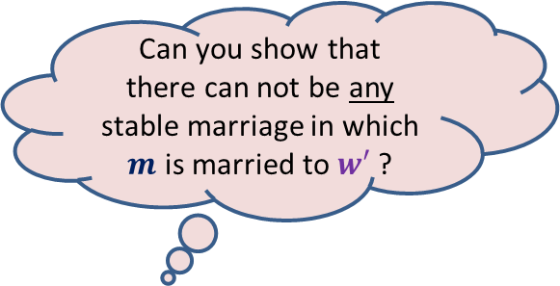
Let us work on an easier problem
Can you show that
there can not be any stable marriage in which $m$ is married to $w′$ ?
Consider the execution of Gale Shapley algorithm.
There are rejections and acceptance of proposals.
Consider the $1$st rejection :
Yes☺
Let $w′$ rejected $m$ for man $m^{′}$in Gale Shapley algorithm.
Surely, $w′$ prefers $m^{′}$ to $m$.
Let MA be any marriage in which $w′$ is married to $m$.
Let $m^{′}$ be married to $w"$ in MA.
Claim: $m′$ must prefer $w′$ to $w"$.
Proof: Since this is the first rejection in the algorithm,
So each engaged man was engaged with his first choice before this rejection.
So $w′$must be the first choice for $m′$.
Hence $m′$ must prefer $w′$ to $w"$.
Let $m$ be rejected by woman $w′$.
How to solve our main problem ?
Generalize this claim for any rejection
and use induction

Slide 7

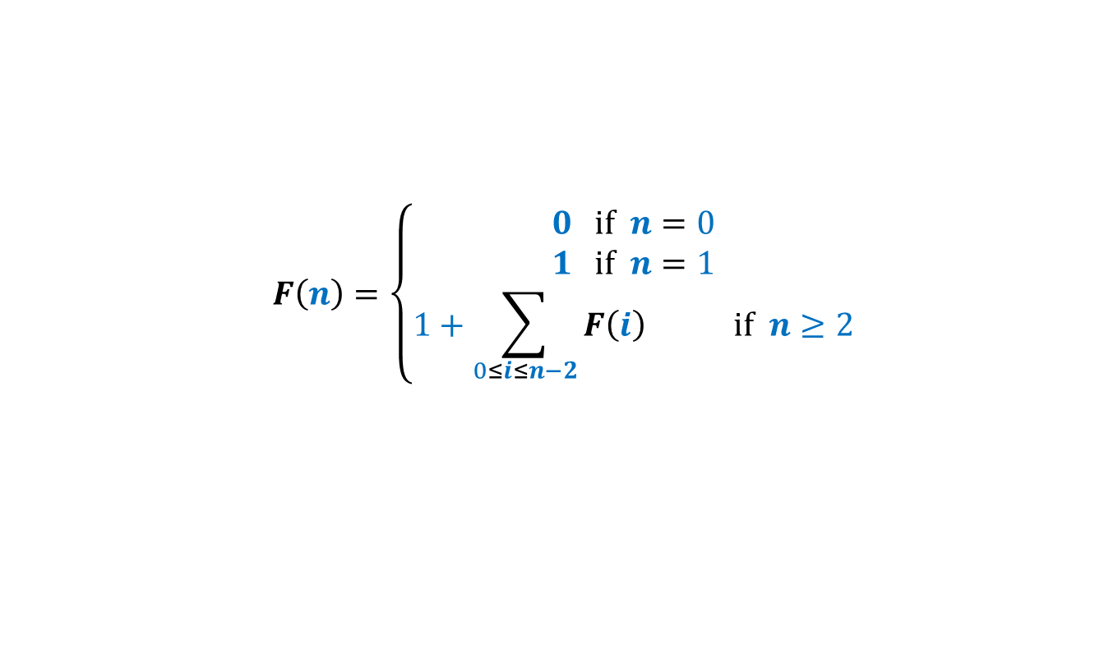
Solving the general problem
Consider the execution of Gale Shapley algorithm.
There are rejections and acceptance of proposals.
For the $i$th rejection :
Let $w′$ rejected $m$ for man $m^{′}$in Gale Shapley algorithm.
Surely, $w′$ prefers $m^{′}$ to $m$.
Let MA be any marriage in which $w′$ is married to $m$.
Suppose $m^{′}$ is married to $w"$ in MA.
Claim: $m′$ must prefer $w′$ to $w"$.
Proof: Let Reject($m^{′}$) be the set of women that rejected $m^{′}$ till $(i−1)$th rejection.
Note : each man proposes to women in decreasing order of preference during the Gale Shapley algo.
Using Induction hypothesis,
there is no stable marriage in which $m^{′}$ is married to any woman in Reject($m^{′}$).
So $w"$ is not in Reject($m^{′}$) since MA is stable.
Moreover, $w′$ is the next most preferred woman from $W\backslash$Reject($m^{′}$)
Hence $w"$ must succeed $w′$ in the preference list of $m$.
Let $m$ be rejected by woman $w′$.
Done.

Slide 8
Finding Median of 5 Trillion numbers
Efficiently using a computer of 1980’s

Slide 9

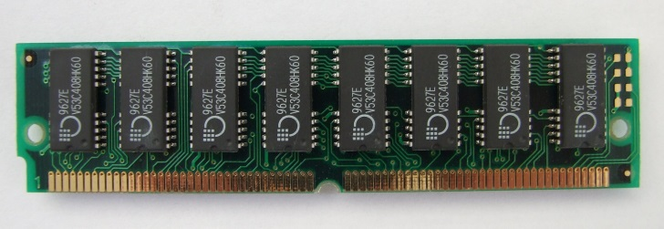
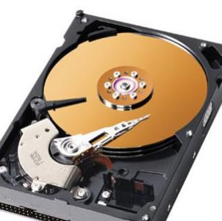
A real computer
Assumption:
Entire input resides in RAM
RAM model
of computation
Input
RAM
But when data is too large …

Slide 10
An accurate model of computer for large data
CPU time: free
Time Complexity : No. of scans to solve the problem
RAM
Disc

Slide 11






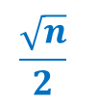

Computing median of $n$ elements
RAM size= $Θ(\sqrt{n})$
Algorithm | No. of scans
O($n$)
$$\frac{\sqrt{n}}{2}$$
Algorithm A
Algorithm B
O($\log{n}$)
Algorithm C
$$2$$
Optimal
Assumptions:
(for ease of understanding)
$n$ = $2^{2k}$
for some $k$
All elements are distinct.

Slide 12
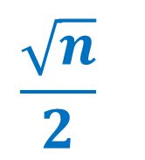
ScAns Algorithm
$$\frac{\sqrt{n}}{2}$$

Slide 13












$\frac{\sqrt{n}}{2}$ scans algorithm
RAM size= $Θ(\sqrt{n})$
Compute smallest $\sqrt{n}$ elements in one scan.
Compute next smallest $\sqrt{n}$ elements in one scan.
Compute next smallest $\sqrt{n}$ elements in one scan.
$$2 7 10 21 42$$
RAM
Effective input size
$$n$$
Can’t we speed it up ?
$$n−\sqrt{n}$$
$$n−2\sqrt{n}$$
$$10$$
$$42$$
$$21$$
$$2$$
$$7$$
Disc

Slide 14

$O(log n)$Scans Algorithm
Approach:
Divide and Conquer

Slide 15



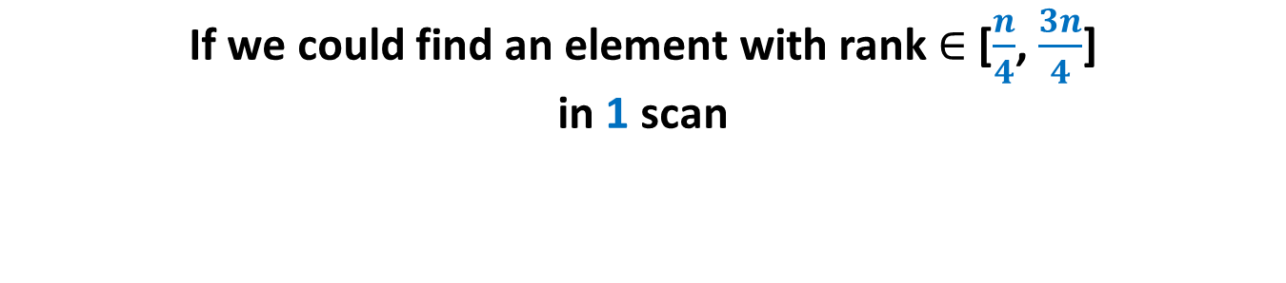

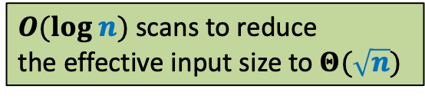




If we could find an element with rank $∈$ [$\frac{n}{4}$, $\frac{3n}{4}$] in 1 scan
RAM size= $Θ(\sqrt{n})$
RAM
Effective input size
$$412$$
Rank $=\frac{n}{3}$
$$\frac{2n}{3}$$
$$\frac{4n}{9}$$
But how to find an element with rank $∈$ [$\frac{n}{4}$, $\frac{3n}{4}$] in 1 scan ?
$$\frac{8n}{27}$$
$$<412$$
$O(log n)$scans to reduce
the effective input size to $Θ(\sqrt{n})$
$$412$$
Disc

Slide 16


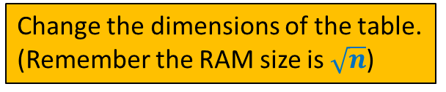

Median of medians algorithm
Recall your DSA course
Element with rank $∈$ [$\frac{3n}{10}$, $\frac{7n}{10}$]
$$\frac{n}{10}$$
$$5$$
How to make use of it to solve the current problem ?
Change the dimensions of the table.
(Remember the RAM size is $\sqrt{n}$)

Slide 17



Median of medians algorithm
Recall your DS course
Element with rank $∈$ [$\frac{n}{4}$, $\frac{3n}{4}$]
$$\sqrt{n}$$
$$\sqrt{n}$$

Slide 18

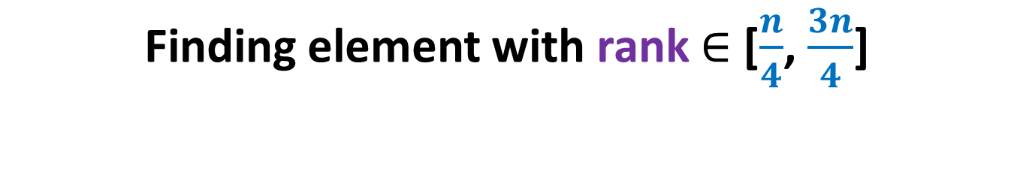
Finding element with rank $∈$ [$\frac{n}{4}$, $\frac{3n}{4}$]
RAM size= $Ω(\sqrt{n})$
RAM
Disc

Slide 19
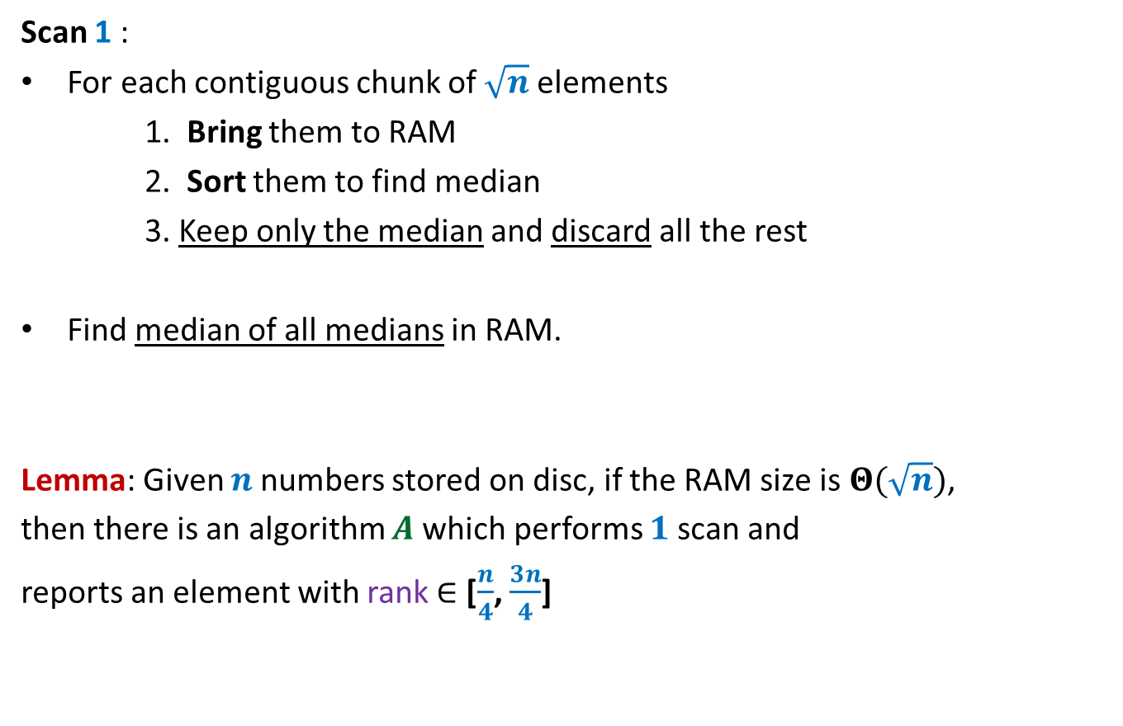
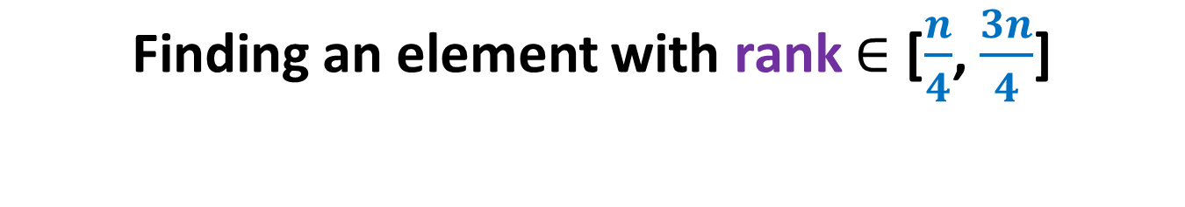
Finding an element with rank $∈$ [$\frac{n}{4}$, $\frac{3n}{4}$]
Scan 1 :
For each contiguous chunk of $\sqrt{n}$ elements
1. Bring them to RAM
2. Sort them to find median
3. Keep only the median and discard all the rest
Find median of all medians in RAM.
Lemma: Given $n$numbers stored on disc, if the RAM size is $Θ(\sqrt{n})$,
then there is an algorithm $A$which performs $1$scan and
reports an element with rank $∈$ [$\frac{n}{4}$, $\frac{3n}{4}$]

Slide 20
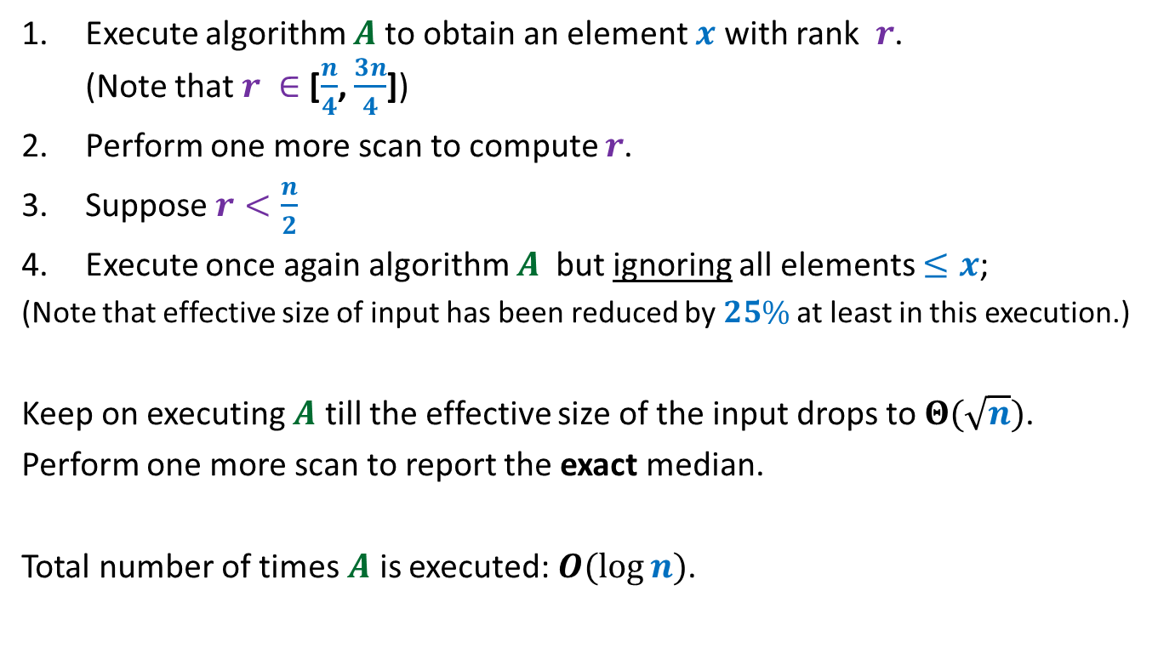

$O(log n)$scan Algorithm
Execute algorithm $A$to obtain an element $x$ with rank $r$. (Note that $r ∈$ [$\frac{n}{4}$, $\frac{3n}{4}$])
Perform one more scan to compute $r$.
Suppose $r<\frac{n}{2}$
Execute once again algorithm $A$ but ignoring all elements $≤x$;
(Note that effective size of input has been reduced by $25\%$ at least in this execution.)
Keep on executing $A$ till the effective size of the input drops to $Θ(\sqrt{n})$.
Perform one more scan to report the exact median.
Total number of times $A$ is executed: $O(\log{n})$.

Slide 21

$2$SCANs Algorithm

Slide 22



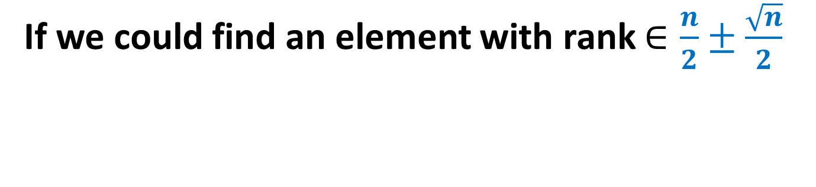


If we could find an element with rank $∈\frac{n}{2}±\frac{\sqrt{n}}{2}$
RAM size= $Θ(\sqrt{n})$
Keep largest $\frac{\sqrt{n}}{2}$ numbers less than $x$
Keep smallest $\frac{\sqrt{n}}{2}$ numbers greater than $x$
=➔ The RAM has the median
RAM
Effective input size
$$x$$
Element with rank $∈$ $\frac{n}{2}±\frac{\sqrt{n}}{2}$
$$\sqrt{n}$$
$$x$$
Disc

Slide 23

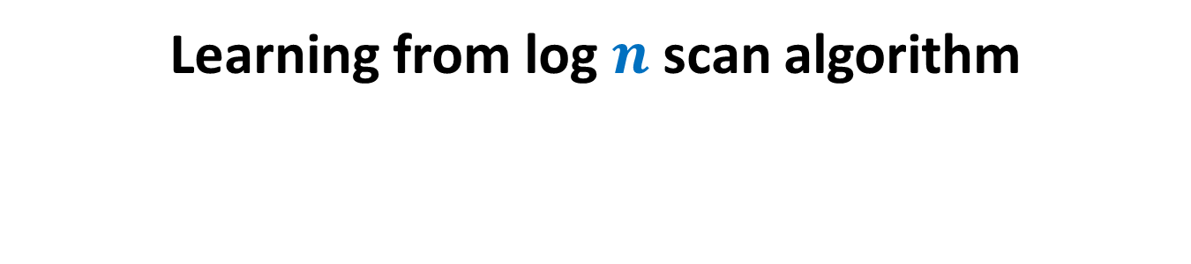



Learning from log $n$scan algorithm
RAM size= $Ω(\sqrt{n})$
RAM
$$\sqrt{n}$$
$$\sqrt{n}$$
$$\sqrt{n}$$
$$\sqrt{n}$$
$$\sqrt{n}$$
$$\sqrt{n}$$
Disc

Slide 24

Learning from log $n$scan algorithm
RAM size= $Ω(\sqrt{n})$
RAM
$$\sqrt{n}$$
$$\sqrt{n}$$
$$\sqrt{n}$$
$$\sqrt{n}$$
$$\sqrt{n}$$
$$\sqrt{n}$$
$$\sqrt{n}$$
Disc

Slide 25

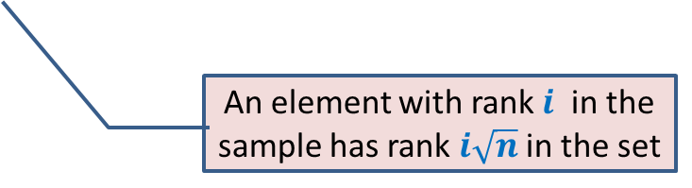


Learning from log $n$scan algorithm
Observation: The $\sqrt{n}$ numbers at the root can be viewed as a “sample” of given $n$ numbers.
Ideally this sample should consist of well-separated numbers.
Unfortunately, there could be a huge deviation.
(For example, median of root could have rank anywhere from $\frac{n}{4}$ to $\frac{3n}{4}$)
AIM: What strategy to use to ensure that the sample consists of well-separated numbers ?
An element with rank $i$ in the sample has rank $i\sqrt{n}$ in the set
$$\sqrt{n}$$
What if sample can be of large size ?
Yes, it is possible if sample size is $\frac{n}{2}$
We will discuss the algorithm next class.

